Slide 1


SIMATS ENGINEERING
Saveetha Institute of Medical and Technical Sciences
Chennai-602105.
CSA1614- Data warehousing and and Data Mining
Intelligent Energy Consumption analytics and forecasting system using usage pattern mining and multidimensional OLAP analysis
M.Tilok sai tej(192525136)
R.RohithManikanta-192425326
N.santhosh(192572107)
R.Thrishank(192572182)
Department of Computer Science and Engineering
SIMATS Engineering

Slide 2
ABSTRACT
The project presents an intelligent system that analyzes energy consumption data to find usage patterns and forecast future demand.
Data is cleaned and stored in MySQL, then processed using KNIME workflows and Python scripts.
Clustering groups consumers by usage behavior, while Decision Tree and Bayesian Classification predict consumption levels.
Multidimensional OLAP analysis explores consumption by time, location and consumer type.
An interactive dashboard presents the results for efficient energy management and planning.

Slide 3
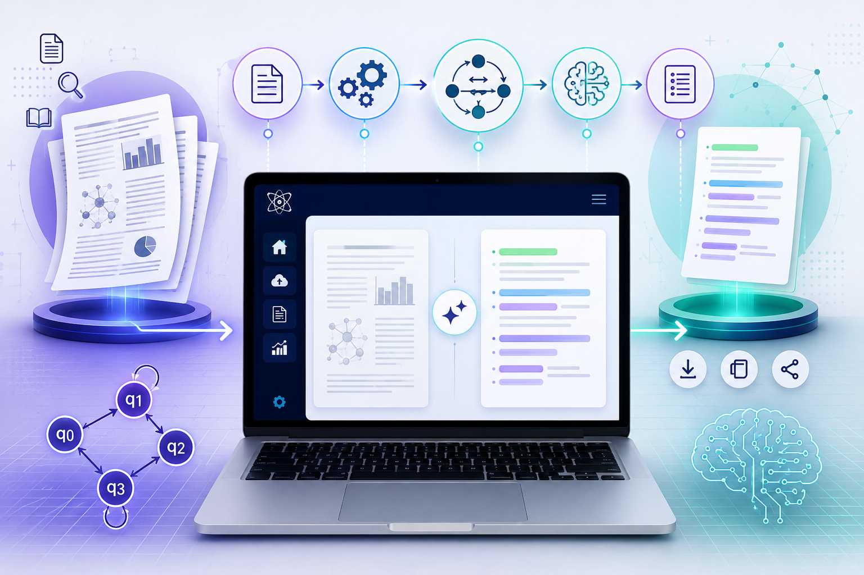
INTRODUCTION
Rising energy demand makes it important to understand how and when electricity is consumed.
Raw smart meter data is large and rarely turned into useful insight.
Data mining can uncover hidden usage patterns and support better energy planning.
This project integrates data management, pattern mining, forecasting and OLAP analysis.
The goal is to reduce energy wastage and enable data-driven decisions.

Slide 4
TOOLS AND TECHNOLOGIES
Python – data preprocessing, model building and visualization.
MySQL – data warehouse for storing energy data and running OLAP queries.
KNIME – visual workflows for data preparation, mining and evaluation.
Decision Tree & Bayesian Classification – predicting energy consumption levels.
Clustering (K-Means) – grouping consumers with similar usage patterns.

Slide 5
INDIVIDUAL CONTRIBUTION
Module 1 – Data Management
Collects, cleans and stores energy data in a MySQL database.
Module 2 – Energy Consumption Analytics & Clustering
Groups consumers and time periods by usage patterns using K-Means.
Module 3 – Energy Forecasting & Prediction
Predicts consumption levels using Decision Tree and Bayesian models.
Module 4 – OLAP & Visualization Dashboard
Enables multidimensional analysis with interactive charts and dashboards.

Slide 6
THANK
YOU

